Slide 1
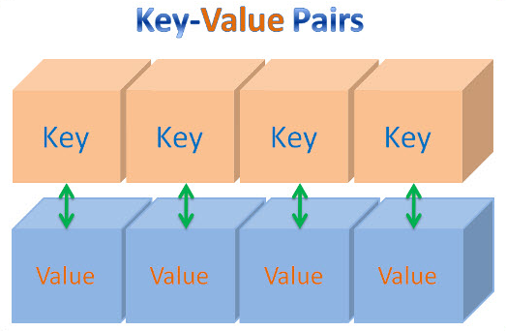
HASHMAPS
PRESENTED BY
B G AKSHAYA

Slide 2
HASHMAP
What?
HashMap is a data structure which uses a concept called Hashing. Hashing is a technique of converting a large String to small String that represents same String. A shorter value helps in indexing and faster searches.
It stores the data in (Key, Value) pairs. To access a value one must know its key.
Why?
HashMap provides constant time complexity for basic operations, get and put, if hash function is properly written and it disperses the elements properly among the buckets.

Slide 3
Features of HashMap are:
HashMap is a part of java.util package.
HashMap extends an abstract class AbstractMap which also provides an incomplete implementation of Map interface.
It also implements Cloneable and Serializable interface. K and V in the above definition represent Key and Value respectively.
HashMap doesn’t allow duplicate keys but allows duplicate values. That means A single key can’t contain more than 1 value but more than 1 key can contain a single value.

Slide 4
Features of HashMap (continued)
HashMap allows null key also but only once and multiple null values.
This class makes no guarantees as to the order of the map; in particular, it does not guarantee that the order will remain constant over time. It is roughly similar to HashTable but is unsynchronized.

Slide 5
Performance of HashMap:
There are two factors contributing to the time complexity of HashMap
Initial Capacity
Capacity is simply the number of buckets (slots) of a HashMap, whereas the Initial Capacity is the capacity of HashMap instance when it is created.
The more the capacity, the more the performance of the HashMap.
However, as the capacity increases, the space complexity increases. There should be good trade-off between the time complexity and capacity.

Slide 6
Performance of HashMap: (continued)
There are two factors contributing to the time complexity of HashMap
2. Load factor
The load factor is a measure of how full the hash table is allowed to get before its capacity is automatically increased.
When the number of entries in the hash table exceeds the product of the load factor and the current capacity, the hash table is rehashed (that is, internal data structures are rebuilt) so that the hash table has approximately twice the number of buckets.

Slide 7
Methods in HashMap class:
1. boolean containsKey(Object key)
Returns true if this map contains a mapping for the specified key.
2. boolean containsValue(Object value)
Returns true if this map maps one or more keys to the specified value.
3. int get(Object key)
Returns the value to which the specified key is mapped, or null if this map contains no mapping for the key.

Slide 8
Methods in HashMap class (continued)
4. boolean isEmpty()
Returns true if this map contains no key-value mappings.
5. Void put(K key, V value)
Associates the specified value with the specified key in this map.
6. void remove(Object key)
Removes the mapping for the specified key from this map if present.

Slide 9
Methods in HashMap class (continued)
7. int size()
Returns the number of key-value mappings in this map.
8. Collection<V> values()
Returns a Collection view of the values contained in this map.

Slide 10
Methods inherited from Map class:
1.equals
boolean equals(Object o)
Compares the specified object with this map for equality. Returns true if the given object is also a map and the two maps represent the same mappings. More formally, two maps m1 and m2 represent the same mappings if m1.entrySet().equals(m2.entrySet()). This ensures that the equals method works properly across different implementations of the Map interface.
Returns:
true if the specified object is equal to this map

Slide 11
Methods inherited from Map class:
2. hashCode
int hashCode()
Returns the hash code value for this map. The hash code of a map is defined to be the sum of the hash codes of each entry in the map's entrySet() view. This ensures that m1.equals(m2) implies that m1.hashCode()==m2.hashCode() for any two maps m1 and m2, as required by the general contract of Object.hashCode().
Returns:
the hash code value for this map

